Slide 1
07: INPUT AND OUTPUT

Slide 2
Formatting Output

Slide 3
Introduction to Output Formatting
Can control how output displays for numeric and string data:
  size
  position
  number of digits
Done through the use of manipulators, special variables or objects that are placed on the output stream.
Most of the standard manipulators are found in <iostream>, some requires <iomanip> header file.

Slide 4
Stream Manipulators
Stream Manipulator | Description
setw(n) | Establishes a print field on n spaces.
fixed | Displays floating-point numbers in fixed point notation.
showpoint | Causes a decimal point and trailing zeros to be displayed, even there is no fractional part.
setprecision(n) | Sets the precision of floating-point numbers.
left | Causes subsequent output to be left justified.
right | Causes subsequent output to be right justified.

Slide 5
Formatting Output: setw()
Used to ouput the value of an expression in a specific number of columns
setw(x) - outputs the value of the next expression in x columns
The output is right-justified
  Example: if you specify the number of columns to be 8 and the output requires only 4 columns, then the first four columns are left blank
If the number of columns specified is less than the number of columns required by the output, the output automatically expands to the required number of columns

Slide 6
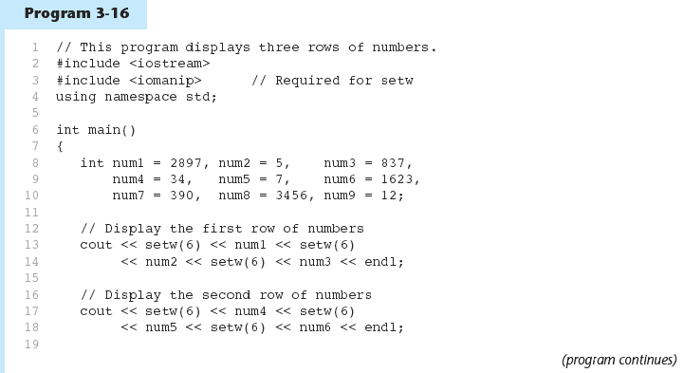
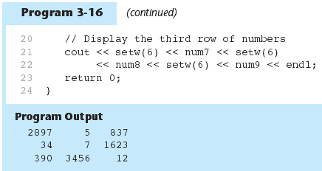
Example 1: setw()

Slide 7
Example 2: setw()
#include <iostream>
#include <iomanip>
using namespace std;
int main()
{
cout << "*" << -17 << "*" << endl;
cout << "*" << setw(6) << -17 << "*" << endl << endl;
cout << "*" << "Hi there!" << "*" << endl;
cout << "*" << setw(20) << "Hi there!" << "*" << endl;
cout << "*" << setw(3) << "Hi there!" << "*" << endl;
return 0;
}
Output:
*-17*
* -17*
*Hi there!*
* Hi there!*
*Hi there!*

Slide 8
Example 1: left and right
#include <iostream>
#include <iomanip>
using namespace std;
int main()
{
int x = 15;
int y = 7634;
cout << left;
cout << setw(5) << x << setw(7) << y << setw(8) << "Warm"
<< endl;
cout << right;
cout << setw(5) << x << setw(7) << y << setw(8) << "Warm"
<< endl;
return 0;
}
Output:
15 7634 Warm
15 7634 Warm

Slide 9
Example 2: left and right
#include <iostream>
#include <iomanip>
using namespace std;
int main()
{
cout << "*" << -17 << "*" << endl;
cout << "*" << setw(6) << -17 << "*" << endl;
cout << left;
cout << "*" << setw(6) << -17 << "*" << endl << endl;
cout << "*" << "Hi there!" << "*" << endl;
cout << "*" << setw(20) << "Hi there!" << "*" << endl;
cout << right;
cout << "*" << setw(20) << "Hi there!" << "*" << endl;
return 0;
}
Output:
*-17*
* -17*
*-17 *
*Hi there!*
*Hi there! *
* Hi there!*

Slide 10
Example 1: fixed
#include <iostream>
using namespace std;
int main()
{
double x = 15.674;
double y = 235.73;
double z = 9525.9874;
cout << fixed;
cout << x << endl << y << endl << z << endl;
return 0;
}
Output:
15.674000
235.730000
9525.987400

Slide 11
Example 2: fixed
#include <iostream>
using namespace std;
int main()
{
float small = 3.1415926535897932384626;
float large = 6.0234567e17;
float whole = 2.000000000;
cout << "Some values in general format" << endl;
cout << "small: " << small << endl;
cout << "large: " << large << endl;
cout << "whole: " << whole << endl << endl;
cout << fixed;
cout << "The same values in fixed format" << endl;
cout << "small: " << small << endl;
cout << "large: " << large << endl;
cout << "whole: " << whole << endl << endl;
return 0;
}
Output:
Some values in general format
small: 3.14159
large: 6.02346e+017
whole: 2
The same values in fixed format
small: 3.141593
large: 602345661202956290.000000
whole: 2.000000

Slide 12
Example 1: showpoint
#include <iostream>
using namespace std;
int main()
{
double x = 15.674;
double y = 235.73;
double z = 9525.9874;
cout << showpoint;
cout << x << endl << y << endl << z << endl;
return 0;
}
Output:
15.6740
235.730
9525.99

Slide 13
Example 2: showpoint
#include <iostream>
using namespace std;
int main()
{
float lots = 3.1415926535, little1 = 2.25;
float little2 = 1.5, whole = 4.00000;
cout << "Some values with noshowpoint (the default)" << endl;
cout << "lots: " << lots << endl;
cout << "little1: " << little1 << endl;
cout << "little2: " << little2 << endl;
cout << "whole: " << whole << endl << endl;
cout << "The same values with showpoint" << endl;
cout << showpoint;
cout << "lots: " << lots << endl;
cout << "little1: " << little1 << endl;
cout << "little2: " << little2 << endl;
cout << "whole: " << whole << endl;
return 0;
}
Output:
Some values with noshowpoint (the default)
lots: 3.14159
little1: 2.25
little2: 1.5
whole: 4
The same values with showpoint
lots: 3.14159
little1: 2.25000
little2: 1.50000
whole: 4.00000

Slide 14
Example: fixed and showpoint
#include <iostream>
using namespace std;
int main()
{
double x = 15.674;
double y = 235.73;
double z = 9525.9874;
cout << fixed << showpoint;
cout << x << endl << y << endl << z << endl;
return 0;
}
Output:
15.674000
235.730000
9525.987400

Slide 15
setprecision() Manipulator
To control the number of significant digits (or precision) of the output, i.e., the total number of digits before and after the decimal point.
However, when used with fixed, it specifies the number of floating-points (i.e., the number of digits after the decimal point).
Without fixed, the setprecision() is set to a lower value, it will print floating-point value using scientific notation.
setprecision(n) – n is the number of significant digits or the number of floating-point (if used with fixed).

Slide 16
Example 1: setprecision()
#include <iostream>
#include <iomanip>
using namespace std;
int main()
{
double x = 15.674;
double y = 235.73;
double z = 9525.9874;
cout << setprecision(2);
cout << x << endl << y << endl << z << endl;
return 0;
}
Output:
16
2.4e+002
9.5e+003

Slide 17
Example 2: setprecision()
#include <iostream>
#include <iomanip>
using namespace std;
int main()
{
double x = 156.74, y = 235.765, z = 9525.9874;
cout << setprecision(5) << x << endl;
cout << setprecision(3) << x << endl;
cout << setprecision(2) << x << endl;
cout << setprecision(1) << x << endl;
cout << fixed << setprecision(2);
cout << x << endl << y << endl << z << endl;
return 0;
}
Output: (VS Code)
156.74
157
1.6e+02
2e+02
156.74
235.76
9525.99

Slide 18
In-Class Exercise
What is the output of the following program:
#include <iostream>
#include <iomanip>
using namespace std;
int main( )
{ double val = 10.345;
cout << setprecision(5) << val << endl; //(a)
cout << setprecision(4) << val << endl; //(b)
cout << setprecision(3) << val << endl; //(c)
cout << setprecision(2) << val << endl; //(d)
cout << setprecision(1) << val << endl; //(e)
cout << "Apa Khabar \n Semua /n" << endl; //(f)
cout << static_cast<int>(val)/2 << endl; //(g)
cout << setw(6) << val*5 << endl; //(h)
cout << showpoint << fixed << setw(8) << val << endl;//(i)
return 0;
}
Output: (VS Code)
10.345
10.35
10.3
10
1e+01
Apa Khabar
Semua /n
5
5e+01
10.3

Slide 19
Formatted Input

Slide 20
Introduction to Input Formatting
Can format field width for use with cin.
Useful when reading string data to be stored in a character array:
const int SIZE = 10;
char firstName[SIZE];
cout << "Enter your name: ";
cin >> setw(SIZE) >> firstName;
cin reads one less character than specified with the setw() manipulator.

Slide 21
Example: Input Formatting
#include <iostream>
#include <iomanip>
using namespace std;
int main()
{
const int SIZE = 10;
char firstName[SIZE];
cout << "Enter your name: ";
cin >> setw(SIZE) >> firstName;
cout << firstName << endl;
return 0;
}
Output:
Enter your name: LeeChongWei
LeeChongW

Slide 22
Example: Problem using cin
#include <iostream>
using namespace std;
int main()
{
string name;
cout << "Enter your name: ";
cin >> name;
cout << name << endl;
return 0;
}
Output 1:
Enter your name: LeeChongWei
LeeChongWei
Output 2:
Enter your name: Lee Chong Wei
Lee

Slide 23
Input Formatting: getline()
To read an entire line of input, use getline().
When reading string data to be stored in a character array, use getline() with two arguments:
  Name of array to store string
  Size of the array
When reading string data to be stored as an object of string, use getline() with two arguments:
  istream object, i.e cin
  string object

Slide 24
Example 1: getline()
#include <iostream>
using namespace std;
int main()
{
const int SIZE = 20;
char firstName[SIZE];
cout << "Enter your name: ";
cin.getline (firstName, SIZE);
cout << firstName << endl;
return 0;
}
Output:
Enter your name: Lee Chong Wei
Lee Chong Wei

Slide 25
Example 2: getline()
#include <iostream>
using namespace std;
int main()
{
string name;
cout << "Enter your name: ";
getline (cin, name);
cout << name << endl;
return 0;
}
Output:
Enter your name: Lee Chong Wei
Lee Chong Wei

Slide 26
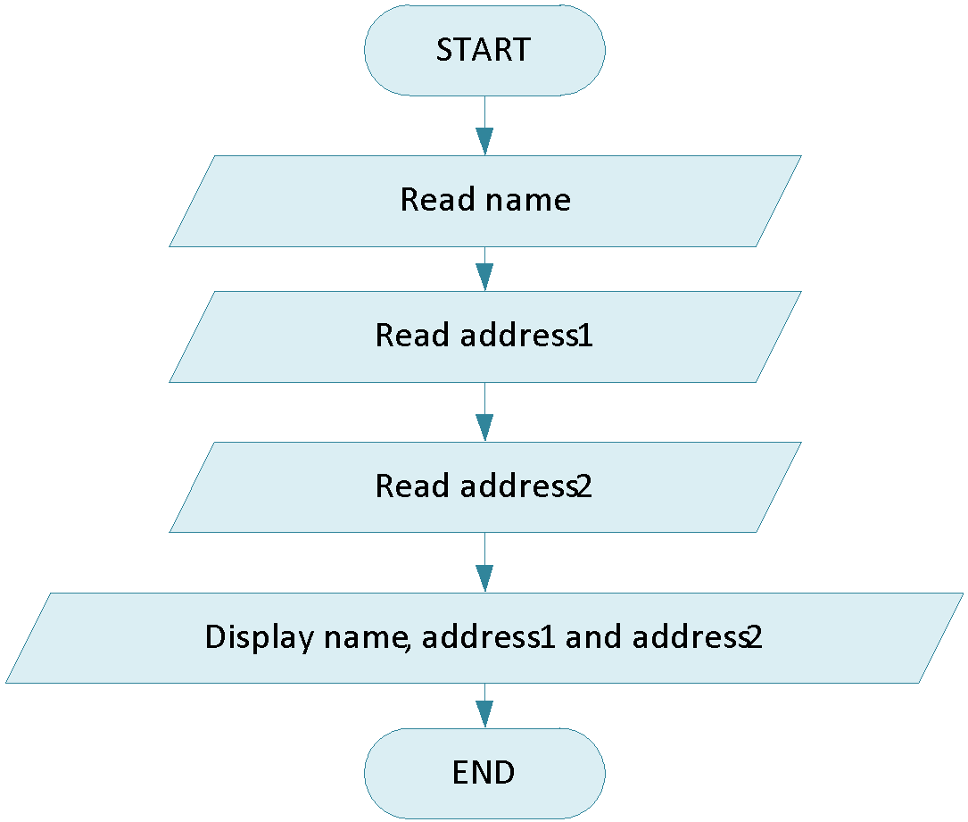
In-Class Exercise
Write C++ program to solve the flow chart:

Slide 27
Input Formatting: get()
To read a single character, use cin.
char ch;
cout << "Strike any key to continue";
cin >> ch;
Problem: will skip over blanks, tabs, <ENTER>
Solution to read a single character, use get().
char ch;
cout << "Strike any key to continue";
cin.get(ch);
Advantage: Will read the next character entered, even whitespace.

Slide 28
In-Class Exercise
Write C++ program to solve the flow chart:

Slide 29
Input Formatting: ignore()
Mixing cin >> and cin.get() in the same program can cause input errors that are hard to detect.
To skip over unneeded characters that are still in the keyboard buffer, use cin.ignore():
//skip next char
cin.ignore();
//skip the next 10 char. @ until a ‘\n'
cin.ignore(10,'\n');

Slide 30
In-Class Exercise
What will be displayed if the user enters the following input:
202
L
#include <iostream>
using namespace std;
int main()
{
int id;
char code;
cout << "Enter an integer id: ";
cin >> id;
cout << "Enter a code: ";
cin.get(code);
cout << "Output\n" << id << "\t" << code;
return 0;
}
Output:
Enter an integer id: 202
Enter a code: Output
202

Slide 31
Introduction to Files

Slide 32
File Input and Output
Can use files instead of keyboard and monitor screen for program input and output.
File: a set of data stored on a computer, often on a disk drive.
  Allows data to be retained between program runs.
Programs can read from and/ or write to files.
Used in many applications: word processing, databases, spreadsheets, compilers.
Steps: (1) Open the file (2) Use the file (read from, write to, or both) (3) Close the file.

Slide 33
File Operations
Requires fstream header file:
  use ifstream data type for input files.
  use ofstream data type for output files.
  use fstream data type for both input, output files.
ifstream:
  Open for input only and file cannot be written to.
  Open fails if file does not exist.
ofstream:
  Open for output only and file cannot be read from.
  File created if no file exists.
  File contents erased if file exists.

Slide 34
File Operations (cont.)
fstream object can be used for either input or output.
fstream: must specify mode on the open statement. Sample modes:
  ios::in for input mode.
  ios::out for output mode.
  ios::binary for binary mode.
  ios::app for append mode. All output operations are performed at the end of the file, appending the content to the current content of the file.

Slide 35
Opening Files
Create a link between file name (outside the program) and file stream object (inside the program).
Filename may include drive and/or path info.
ifstream and ofstream - use the open() member function:
infile.open("inventory.dat");
outfile.open("report.txt");
fstream - use the open() member function and mode(s):
infile.open("inventory.dat", ios::in);
outfile.open("report.txt", ios::out);

Slide 36
Opening Files (cont.)
fstream - can be combined on open call:
dFile.open("class.txt", ios::in | ios::out);
Can open file at declaration:
ifstream gradeList("grades.txt");
fstream infile("inventory.dat", ios::in);
fstream file("class.txt", ios::in | ios::out);
Output file will be created if necessary; existing file will be erased first.
Input file must exist for open to work.

Slide 37
Opening Files (cont.)
File stream object set to 0(false), if open failed. Example:
if (!input)
{ cout << “ERROR: Cannot open file\n”;
exit(1); }
Can use fail() member function to detect file open error:
if (input.fail())
{ cout << “ERROR: Cannot open file\n”;
exit(1); }
Can use is_open() member function to check if a file is open:
if (!input.is_open())
{ cout << “ERROR: Cannot open file\n”;
exit(1); }

Slide 38
Using Files
Can use output file object and << to send data to a file:
outfile << "Inventory report";
Can use input file object and >> to copy data from file to variables:
infile >> partNum;
infile >> qtyInStock >> qtyOnOrder;
Can use eof() member function to test for end of input file.

Slide 39
Closing Files
Use the close() member function:
infile.close();
outfile.close();
Don’t wait for operating system to close files at program end:
  may be limit on number of open files.
  may be buffered output data waiting to send to file.

Slide 40
Example 1: File Operations
#include <iostream> //copy 10 numbers between files
#include <fstream>
using namespace std;
int main()
{
fstream infile("input.txt", ios::in); // open the files
fstream outfile("output.txt", ios::out);
int num;
for (int i = 1; i <= 10; i++) {
infile >> num; // use the files
outfile << num; }
infile.close(); // close the files
outfile.close();
}

Slide 41
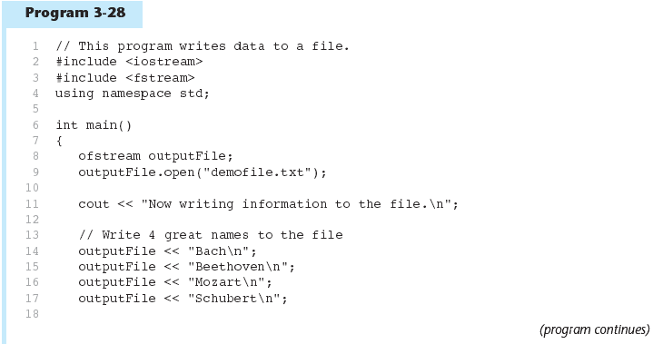
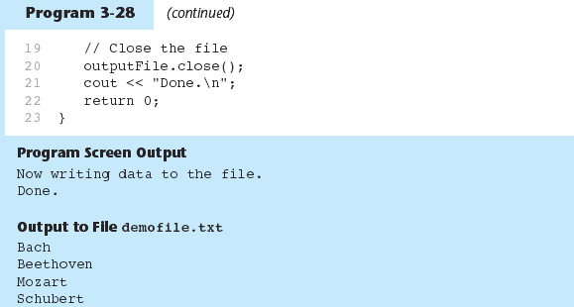
Example 2: File Operations

Slide 42
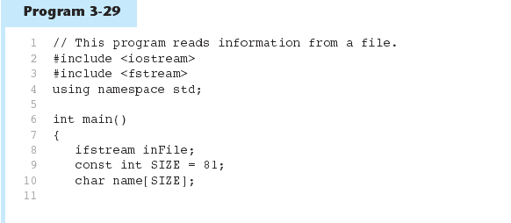
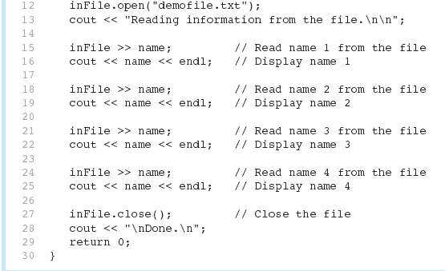
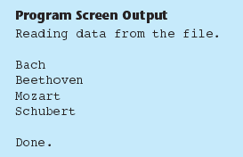
Example 3: File Operations

Slide 43
Example 4: File Operations
#include <fstream>
using namespace std;
int main()
{
ifstream input("inputfile.txt");
char str[80];
if (!input)
{
cout << "While opening a file an error is encountered" << endl;
return 0;
}
else
cout << "File is successfully opened" << endl; while(!input.eof())
{
input.getline(str, 80);
cout << str << endl;
}
input.close();
return 0;
}

Slide 44
Example 5: File Operations
#include <iostream>
#include <fstream>
using namespace std;
int main ()
{
int num;
ifstream inp("input.txt"); // open the input file
ofstream out("output.txt"); // open the output file
if (!inp.is_open()) // check for successful opening
{
cout << "Input file could not be opened! Terminating!\n;
return 0;
}
while (inp >> num)
out << num * 2 << endl;
inp.close();
out.close();
cout << "Done!" << endl;
return 0;
}

